Slide 1
What is a Professional Moai?
A Professional Moai is a group of 6 to 10 participants who will meet to serve as peer mentors for each other, discussing professional development, career growth, and ways to overcome challenges in the workplace.
What does the term Moai mean?
Moai means "meeting for a common purpose" in Japanese; pronounced (Mo-ai)
https://www.nytimes.com/2018/07/10/well/the-power-of-positive-people.html
No worries – no lifetime commitments required ☺

Slide 2
What is the Level of Commitment to join a Moai?
Approximate level of commitment: ~4 times a year to meet in person and/or virtually for group networking and discussion
Would you be willing to be a co-lead for a Moai?
Role of Co-lead: there will be 2 to 3 co-leads per Professional Moai and they will help organize and facilitate the Professional Moai get-togethers/discussions.
No experience is necessary to be a co-lead and support will be provided in terms of sharing best practices, discussion topic ideas, and initial training.

Slide 3
Why join a Professional Moai?
During the Inaugural Boston Women in Pharma® event in June 2018 attendees expressed they would find it valuable to have a small networking group to facilitate deeper and supportive networking relationships.
The other Moai members can give you unbiased input on professional challenges or opportunities you may have.
A group of positive supporters can go a long way to encourage your leadership confidence and development.

Slide 4
How do I sign up for a Moai and/or
to be a Co-Lead?
The Boston Women in Pharma® on-line Intake Form includes questions on Professional Moais. You can sign up and provide the info to help us form the Moai groups.
You can sign up tonight on the available laptops!
https://www.ispeboston.org/women-in-pharma-intake-form/

Slide 5
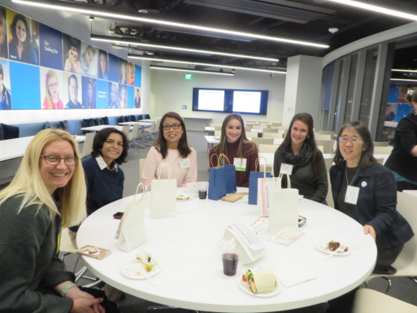
How and when will the Moai Groups be Formed?
The answers to the Moai questions in the intake form will help form the groups, including:
What town do you work in and the town live in?
Your geographic preference of where would be most preferable for you to meet.
What is your primary objective for participation and what benefits are you looking to gain from a Professional Moai? In other words, what gets you excited about joining a Professional Moai?
We will advertise the Moai sign-up for a few more weeks and then form the initial groups during May.
Then we will bring the co-leads together to share ideas and tools and then the Moais will be ready to start meeting!!

Slide 6
Time for Brewery Tours and
more Mingle Bingo!!

Slide 7
Thank you to our Event Sponsor!
Ask us how your company can sponsor our next event.
We would love to have your support!

Slide 8
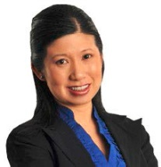
Join Future Women in Pharma Events and Initiatives!
Launching of Professional Moais (Peer Mentor Circles) – in May/June
May 22nd – “Present” Yourself to Success with Public Speaking – with Mary Cheyne
June 19th - Women in Pharma® Breakfast and Panel Event during ISPE International Biopharmaceutical Manufacturing Conference
Sept 18th - Break out Session at ISPE Boston Product Show

